Slide 1
Web Adv
PHP: Codeigniter (CI)

Slide 2
MVC-framework
Centraal idee
Code wordt opgesplitst in 3: Model, View en Controller
Voordelen:
Beter leesbare, eenvoudiger te onderhouden code
Veel voorgedefinieerde plugins, libraries:
      Captcha
      Form validatie
      XSS bescherming
      ...

Slide 3
MVC
Controller
ontvangt HTTP-request
vanuit de controller wordt view en model aangeroepen
Model = interactie met externe data (MySQL)
View = presentatie (HTML, CSS)
The model-view-controller (MVC) pattern lets you break up code into logical objects that serve very specific purposes. Models serve as a data access layer where data is fetched and returned in format usable throughout your application.
Controllers handle the request, process the data returned from models and load views to send in the response. And views are display templates (markup, xml, etc) that are sent in the response to the web browser.

Slide 4
Installatie
Download via https://github.com/codeigniter4/framework
Kopieer de inhoud van de map framework-master naar /var/www/html
Map /var/www/html/public/ moet DocumentRoot v. server zijn.
Pas /etc/apache2/sites-available/000-default.conf aan:
herstart de service apache2: sudo service apache2 restart
<VirtualHost *:80>
DocumentRoot "/var/www/html/public/"
ServerName webadv
ServerAlias webadv
<Directory "/var/www/html/public/">
AllowOverride All
Require all granted
</Directory>
</VirtualHost>
Notes:
*
07/16/96
*

Slide 5
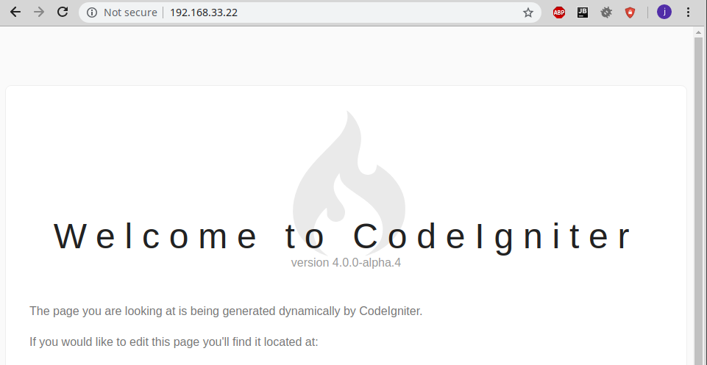
Voorbeeld1
http://192.168.33.22/
http://192.168.33.22/index.php
http://192.168.33.22/Home
http://192.168.33.22/home
http://192.168.33.22/index.php/Home
http://192.168.33.22/Home/index
...
Notes:
*
07/16/96
*

Slide 6
app/Config/app.php
<?php namespace Config;
use \CodeIgniter\Config\BaseConfig;
class App extends BaseConfig
{
/*
|-----------------------------------------------
| Base Site URL
|-----------------------------------------------
*/
public $baseURL = 'http://192.168.33.22/';
...

Slide 7
Routing:
URL --> methode uit Controller class
altijd geldt
http://192.168.33.22/index.php/Home/index --> class Home method index
http://192.168.33.22/Home/index --> class Home method index
bijkomende regels in app/Config/Routes.php
app/Config/Routes.php
...
$routes->setDefaultController('Home');
$routes->setDefaultMethod('index');
...
Configuratie in Routes.php:
http://192.168.33.22/Home --> class Home, default method index
http://192.168.33.22/ --> default class Home,
default method index

Slide 8
app/Config/Routes.php
...
$routes->setDefaultController('Home');
$routes->setDefaultMethod('index');
...
$routes->get('/', 'Home::index');
http://192.168.33.22/ --> class Home, method index

Slide 9
app/Controllers/Home.php
<?php namespace App\Controllers;
use \CodeIgniter\Controller;
class Home extends Controller
{
public function index()
{
return view('welcome_message');
}
}
view welcome_message wordt geladen

Slide 10
app/views/welcome-message.php
<!doctype html>
<html>
<head>
<title>Welcome to CodeIgniter</title>
</head>
<body>
...
<div class="guide">
<p>The page you are looking at is being
generated dynamically by
CodeIgniter.</p>
</div>
</body>
</html>

Slide 11
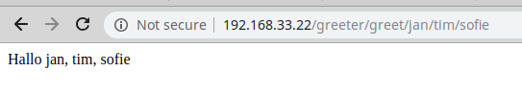
Voorbeeld2: Greeter
argumenten van greet
class Greeter
methode greet
Notes:
*
07/16/96
*

Slide 12
app/Controller/Greeter.php
<?php namespace App\Controllers;
use \CodeIgniter\Controller;
class Greeter extends Controller
{
public function greet()
{
$who=func_get_args();
$data=['who'=>$who];
return view('greet_view',$data);
}
}
De view greet_view wordt geladen,
de array $data met key 'who' wordt meegegeven aan de view

Slide 13
app/views/greet_view.php
<!doctype html>
<html>
<head>
<title>Welcome</title>
</head>
<body>
Hallo
<?php print(implode(", ", $who)); ?>
</body>
</html>
variabele $who uit functie index in de controller Greeter

Slide 14


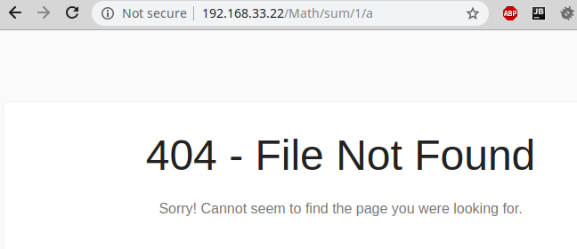
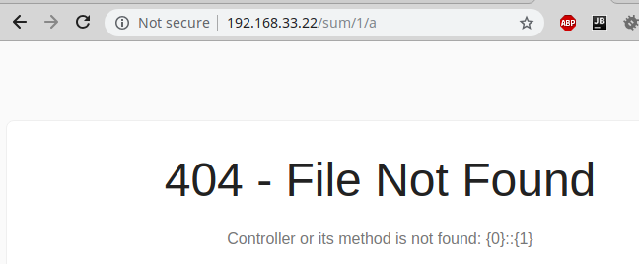
Voorbeeld3: Math
Notes:
*
07/16/96
*

Slide 15
app/Config/Routes.php
...
$routes->get('sum/(\d+)/(\d+)', 'Math::sum/$1/$2');
...
Route adhv regex

Slide 16
app/Controller/Math.php
<?php namespace App\Controllers;
use \CodeIgniter\Controller;
use \CodeIgniter\Exceptions\PageNotFoundException;
class Math extends Controller
{
public function sum()
{
$numbers = func_get_args();
$sum = 0;
foreach($numbers as $number){
if (! preg_match('/^\s*\d+\s*$/', $number)){
throw new PageNotFoundException();
}
$sum += $number;
}
$data=['numbers'=>$numbers, 'sum'=>$sum];
return view('sum_view',$data);
}
}

Slide 17
app/views/sum_view.php
<!doctype html>
<html>
<head>
<title>Sum</title>
</head>
<body>
<?php print(implode("+ ", $numbers)); ?>
=
<?php print($sum); ?>
</body>
</html>

Slide 18
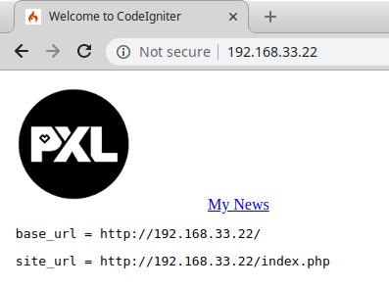
Voorbeeld4: helpers
CSS, JS, images in de map public/assets
html-helper: link_tag, scipt_tag, img,
url-helper: anchor, base_url
https://codeigniter4.github.io/CodeIgniter4/helpers/url_helper.html
https://codeigniter.com/user_guide/helpers/html_helper.html

Slide 19
app/Controllers/Home.php
<?php namespace App\Controllers;
use \CodeIgniter\Controller;
class Home extends Controller
{
public function index()
{
helper(['url','html']);
return view('welcome_message');
}
}

Slide 20
app/views/welcome-message.php
<!doctype html>
<html>
<head>
<title>Welcome to CodeIgniter</title>
<?php print (link_tag('assets/css/mystyle.css'));?>
</head>
<body>
<?php
$imageProperties = [
'src' => 'assets/images/pxl_it.png',
'alt' => 'PXL IT logo',
'width' => '200',
];
print(img($imageProperties));
print(anchor('news/1', 'My News'));
?>
<pre> base_url = <?php print(base_url()); ?></pre>
<pre> site_url = <?php print(site_url()); ?></pre>
<?php print(script_tag('assets/js/mystyle.js'));?>
</body>
</html>

Slide 21
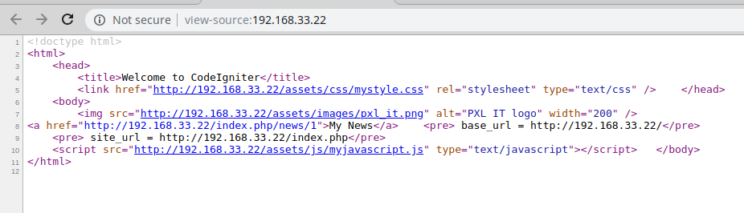
link_tag('assets/css/mystyle.css')

Slide 22
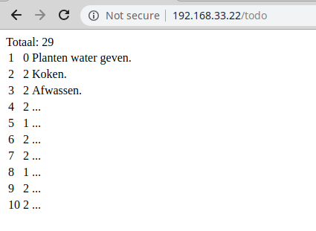
Voorbeeld4: database
DROP DATABASE IF EXISTS todo;
CREATE DATABASE IF NOT EXISTS todo;
USE todo;
DROP TABLE IF EXISTS `todolist`;
CREATE TABLE IF NOT EXISTS `todolist` (`id` int auto_increment, `priority` int, `text` text, primary key (`id`));
INSERT INTO `todolist` (`id`, `priority`, `text`) VALUES
(1, 0, 'Planten water geven.'),
(2, 2, 'Koken.'),
(3, 2, 'Afwassen.'),
(4, 2, '...'),
(5, 1, '...'),
(6, 2, '...'),
(7, 2, '...'),
(8, 1, '...'),
(9, 2, '...'),
(10, 2, '...'),
(11, 0, '...'),
(12, 2, '...'),
(13, 0, '...'),
(14, 2, '...'),
(15, 1, '...'),
(16, 2, '...'),
(17, 2, '...'),
(18, 0, '...'),
(19, 2, '...'),
(20, 2, '...'),
(21, 0, '...'),
(22, 2, '...'),
(23, 0, '...'),
(24, 2, '...'),
(25, 1, '...'),
(26, 2, '...'),
(27, 2, '...'),
(28, 0, '...'),
(29, 2, '...');

Slide 23
app/Config/Database.php
/**
* The default database connection.
*/
public $default = [
'DSN' => '',
'hostname' => 'localhost',
'username' => 'root',
'password' => 'root',
'database' => 'todolist',
'DBDriver' => 'MySQLi',
'DBPrefix' => '',
'pConnect' => false,
'DBDebug' => (ENVIRONMENT !== 'production'),
'cacheOn' => false,
'cacheDir' => '',
'charset' => 'utf8',
'DBCollat' => 'utf8_general_ci',
'swapPre' => '',
'encrypt' => false,
'compress' => false,
'strictOn' => false,
'failover' => [],
'port' => 3306,
];

Slide 24
app/Models/TodoModel.php
<?php namespace App\Models;
use CodeIgniter\Model;
class TodoModel extends Model
{
protected $table = 'todolist';
protected $returnType = '\App\Entities\Todo';
protected $allowedFields = [ 'priority', 'text' ];
public function countTodo()
{
$query = $this->db->query(
'SELECT COUNT(*) AS count FROM '. $this->table);
$result = $query->getResult();
return $result[0]->count;
}
}
methode findAll, insert, update: gedefinieerd in Model
allowedFields: list all of the field names that can be changed during inserts (methode insert) and updates (methode update)

Slide 25
app/Entities/Todo.php
<?php namespace App\Entities;
class Todo
{
protected $id;
protected $priority;
protected $text;
public function __get($key)
{
if (property_exists($this, $key)){
return $this->$key;
}
}
public function __set($key, $value)
{
if (property_exists($this, $key)){
$this->$key = $value;
}
}
}

Slide 26
app/Controllers/Todo.php
<?php namespace App\Controllers;
use \CodeIgniter\Controller;
use \CodeIgniter\Exceptions\PageNotFoundException;
use \App\Models\TodoModel;
class Todo extends Controller
{
public function index()
{
$todoModel=new TodoModel();
$count = $todoModel->countTodo();
$todoList=$todoModel->findAll(10,0);
$data=[ 'todoList'=>$todoList,
'count' => $count ];
return view('todo_view',$data);
}
}

Slide 27
app/Views/todo_view.php
<!doctype html>
<html>
<head>
<title>Todo</title>
</head>
<body>
Totaal: <?php print($count);?>
<table>
<?php
foreach($todoList as $todoItem){
print("<tr><td>".
$todoItem->id . "</td><td>" .
$todoItem->priority . "</td><td>" .
$todoItem->text . "</td></tr>" );
}
?>
</table>
</body>
</html>

Slide 28
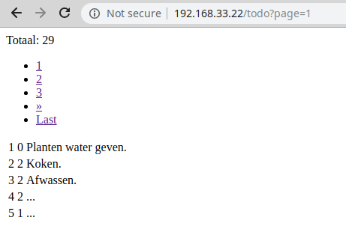
Voorbeeld5: pagination

Slide 29
app/Controllers/Todo.php
<?php namespace App\Controllers;
use \CodeIgniter\Controller;
use \CodeIgniter\Exceptions\PageNotFoundException;
use \App\Models\TodoModel;
class Todo extends Controller
{
public function index()
{
$todoModel=new TodoModel();
$count = $todoModel->countTodo();
$todoList = $todoModel->paginate(5);
$data = [ 'todoList'=>$todoList,
'count' => $count,
'pager' => $todoModel->pager ];
return view('todo_view',$data);
}
}

Slide 30
app/Views/todo_view.php
<!doctype html>
<html>
<head>
<title>Todo</title>
</head>
<body>
Totaal: <?php print($count);?>
<?php print($pager->links()); ?>
<table>
<?php
foreach($todoList as $todoItem){
print("<tr><td>".
$todoItem->id . "</td><td>" .
$todoItem->priority . "</td><td>" .
$todoItem->text . "</td></tr>" );
}
?>
</table>
</body>
</html>

Slide 31
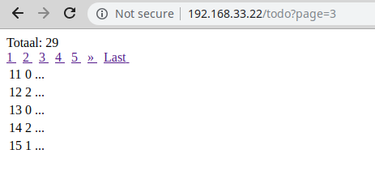
Voorbeeld6: pagination (view)

Slide 32
System/Pager/Views/default_full.php
<?php
/**
* @var \CodeIgniter\Pager\PagerRenderer $pager
*/
$pager->setSurroundCount(2);
?>
<nav aria-label="<?= lang('Pager.pageNavigation') ?>">
<span class="pagination"><span>
<?php if ($pager->hasPrevious()) : ?>
<span>
<a href="<?= $pager->getFirst() ?>" aria-label="<?= lang('Pager.first') ?>">
<span aria-hidden="true"><?= lang('Pager.first') ?></span>
</a>
&nbsp;
</span>
<span>
<a href="<?= $pager->getPrevious() ?>" aria-label="<?= lang('Pager.previous') ?>">
<span aria-hidden="true">&laquo;</span>
</a>
&nbsp;
</span>
<?php endif ?>
<?php foreach ($pager->links() as $link) : ?>
<span <?= $link['active'] ? 'class="active"' : '' ?>>
<a href="<?= $link['uri'] ?>">
<?= $link['title'] ?>
</a>
&nbsp;
</span>
<?php endforeach ?>
<?php if ($pager->hasNext()) : ?>
<span>
<a href="<?= $pager->getNext() ?>" aria-label="<?= lang('Pager.next') ?>">
<span aria-hidden="true">&raquo;</span>
</a>
&nbsp;
</span>
<span>
<a href="<?= $pager->getLast() ?>" aria-label="<?= lang('Pager.last') ?>">
<span aria-hidden="true"><?= lang('Pager.last') ?></span>
</a>
&nbsp;
</span>
<?php endif ?>
</span>
</nav>

Slide 33
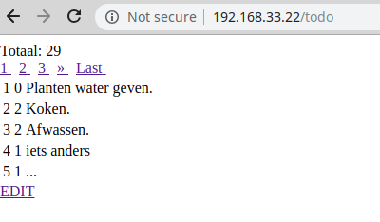
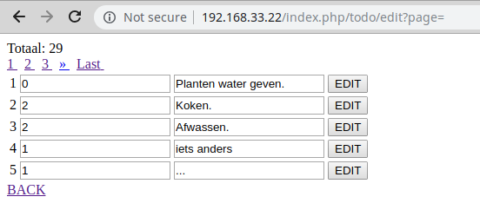
Voorbeeld 7: edit

Slide 34
app/Controllers/Todo.php
<?php namespace App\Controllers;
use \CodeIgniter\Controller;
use \CodeIgniter\Exceptions\PageNotFoundException;
use \App\Models\TodoModel;
class Todo extends Controller
{
public function index()
{
helper(['url', 'html']);
$todoModel=new TodoModel();
$count = $todoModel->countTodo();
$todoList = $todoModel->paginate(5);
$page = $this->request->getGet('page');
$data=[ 'todoList' => $todoList,
'count' => $count,
'pager' => $todoModel->pager,
'page' => $page ];
return view('todo_view',$data);
}
...

Slide 35
public function edit()
{
helper(['url', 'html', 'form']);
$todoModel=new TodoModel();
$submit = $this->request->getPost('submit');
if ($submit != null){
$id = $this->request->getPost('id');
$text = $this->request->getPost('text');
$priority = $this->request->getPost('priority');
$todoModel->update($id,
[ 'text' => $text,
'priority' => $priority]
);
}
$count = $todoModel->countTodo();
$todoList = $todoModel->paginate(5);
$page = $this->request->getGet('page');
$data=[ 'todoList'=> $todoList,
'count' => $count,
'pager' => $todoModel->pager,
'page' => $page ];
return view('todo_edit_view',$data);
}
}

Slide 36
app/Views/todo_view.php
<!doctype html>
<html>
<head>
<title>Todo</title>
</head>
<body>
Totaal: <?php print($count);?>
<?php print($pager->links()); ?>
<table>
<?php
foreach($todoList as $todoItem){
print("<tr><td>". $todoItem->id . "</td><td>" .
$todoItem->priority . "</td><td>" .
$todoItem->text . "</td></tr>" );
}
?>
</table>
<?php print(anchor('/todo/edit?page='. $page,
'EDIT'));?>
</body>
</html>

Slide 37
app/Views/todo_edit_view.php
<!doctype html>
<html>
<head>
<title>Todo</title>
</head>
<body>
Totaal: <?php print($count);?>
<?php print($pager->links()); ?>
<table>
<?php
foreach($todoList as $todoItem){
print(form_open('/todo/edit?page='. $page));
print('<tr><td>');
print(form_input([
'name' => 'id',
'value' => $todoItem->id,
'type' => 'hidden'
]));
print($todoItem->id);

Slide 38
app/Views/todo_edit_view.php
print('</td><td>');
print(form_input([
'name' => 'priority',
'value' => $todoItem->priority
]));
print('</td><td>');
print(form_input([
'name' => 'text',
'value' => $todoItem->text
]));
print(form_submit([
'name' => 'submit',
'value' => 'EDIT'
]));
print('</td></tr>');
print(form_close());
}
?>
</table>
<?php print(anchor('/todo?page='. $page, 'BACK'));?>
</body>

Slide 39
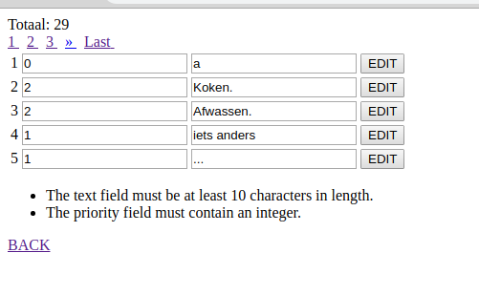
Voorbeeld 8: validation

Slide 40
app/Controllers/Todo.php
<?php namespace App\Controllers;
use \CodeIgniter\Controller;
use \CodeIgniter\Exceptions\PageNotFoundException;
use \App\Models\TodoModel;
class Todo extends Controller
{
public function index()
{
helper(['url', 'html']);
$todoModel=new TodoModel();
$count = $todoModel->countTodo();
$todoList = $todoModel->paginate(5);
$page = $this->request->getGet('page');
$data=[ 'todoList' => $todoList,
'count' => $count,
'pager' => $todoModel->pager,
'page' => $page ];
return view('todo_view',$data);
}
...

Slide 41
public function edit()
{
helper(['url', 'html', 'form']);
$todoModel=new TodoModel();
$submit = $this->request->getPost('submit');
if ($submit != null ){
$rules=[
'text' => ['label' => 'text',
'rules' => 'required|min_length[10]' ],
'priority' => ['label' => 'priority',
'rules' => 'required|integer|in_list[1,2,3]']
];
$this->validate($rules);
$id = $this->request->getPost('id');
$text = $this->request->getPost('text');
$priority = $this->request->getPost('priority');
$todoModel->update($id, [ 'text' => $text,
'priority' => $priority] );
}

Slide 42
$count = $todoModel->countTodo();
$todoList = $todoModel->paginate(5);
$page = $this->request->getGet('page');
$data=[ 'todoList'=> $todoList,
'count' => $count,
'pager' => $todoModel->pager,
'page' => $page,
'validator' => $this->validator
];
return view('todo_edit_view',$data);
}
}

Slide 43
app/Views/todo_edit_view.php
<!doctype html>
<html>
<head>
<title>Todo</title>
</head>
<body>
Totaal: <?php print($count);?>
<?php print($pager->links()); ?>
<table>
<?php
foreach($todoList as $todoItem){
print(form_open('/todo/edit?page='. $page));
print('<tr><td>');
print(form_input([
'name' => 'id',
'value' => $todoItem->id,
'type' => 'hidden'
]));
print($todoItem->id);

Slide 44
app/Views/todo_edit_view.php
print('</td><td>');
print(form_input([
'name' => 'priority',
'value' => $todoItem->priority
]));
print('</td><td>');
print(form_input([
'name' => 'text',
'value' => $todoItem->text
]));
print(form_submit([
'name' => 'submit',
'value' => 'EDIT'
]));
print('</td></tr>');
print(form_close());
}
?>
</table>
<?php print ($validator ==null ?
"" : $validator->listErrors()); ?>
<?php print(anchor('/todo?page='. $page, 'BACK'));?>
</body>

